Slide 1
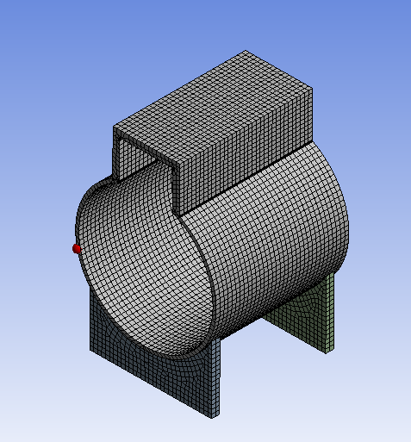
Plastic collapse study using limit load analysis for a non-circular Pressure vessel using international codes(ASME Section VIII Division 2)
Presented by
Kingston Rivington (ASME Authorised Inspector)

Slide 2
Introduction
The various roles of pressure vessel are significant in the Oil & Gas, chemical, petrochemical industries etc. It maybe in various forms like column, horizontal vessel, heat exchangers, reactors so on. The ASME Section VIII division 2 provides the design-by Formula approach & numerical Analysis approach.
The Part of 5 of div2 of design by analysis approach utilizes the results from a numeric stress analysis to evaluate vessel components for plastic collapse and non-regular geometry.
In this paper the limit load method is chosen to study a non-circular vessel as there are fewer literatures available on numerical study.(many designer not prefer this geometry )

Slide 3
Design approaches on pressure vessel& its components
Mostly two types.
Design by set of rules or formulae
Design by Analysis (FEA)

Slide 4
Design by set of rules or formulae
The Vessel Geometry and major dimension such as radius, length , etc. are specified.
Closed form equations.
Higher design margin ( SOF)
Higher Allowable stress

Slide 5
Design by analysis approach(FEA)
The pressure vessel and its components has the following.
Very large opening,
Non-circular type pressure components
complex geometries such tube sheets in HE, bellow joints etc
Flange Bolted joints for leak tightness
Failure analysis for fatigue screening /cycles (stress or strain life)
Facture mechanics etc (impact strength)

Slide 6
Common design by analysis international code of practices as below,
US- ASME Boiler and pressure vessel section III & VIII
UK-PD 5500 Unfired fusion welded pressure vessels
EU- EN 13145 Unfired Pressure vessels

Slide 7
Summary of the study
As per ASME Sec VIII div 2, the nonlinear solution shall be converged for acceptance for all vessel components under the applied load cases. In this case, the convergence was achieved in the nonlinear solution.
Thus, the vessel passes the limit load analysis. But still we need to find out maximum limit load for plastic collapse.
Further load was increased in incremental steps from 0.6 to 2.1 MPa and the collapse load with the associated plastic strains and displacements were found.(addressed in table 1)

Slide 8
ASME section VIII Div.2
The Part 5 of Div.2 provides details guideline and procedure perform different type of FE analysis.
There are four mandatory checks
- Protection Against Plastic collapse
- Protection Against Local Failure
- Protection Against Collapse from Buckling
- Protection Against failure from Cyclic Loading

Slide 9
What is Plastic collapse check in pressure components ?
As per ASME the definition of Limit-Load Method is “ A calculation is performed to determine a lower bound to the limit load of a component. The allowable load on the component is established by applying design factors to the limit load such that the onset of gross plastic deformations (plastic collapse) will not occur”
In other words(layman) ,”Plastic collapse is defined where there is general or local ductile failure of section of pressure vessel when applying internal or external load such as pressure, nozzle thrust, dead load etc , that exceed or across the yield strength”
.

Slide 10
Types of Plastic Load checks
The ASME Section VIII div.2 provides three types of collapse check,
Elastic Stress Analysis Method
Limit-Load Method
Elastic–Plastic Stress Analysis Method

Slide 11
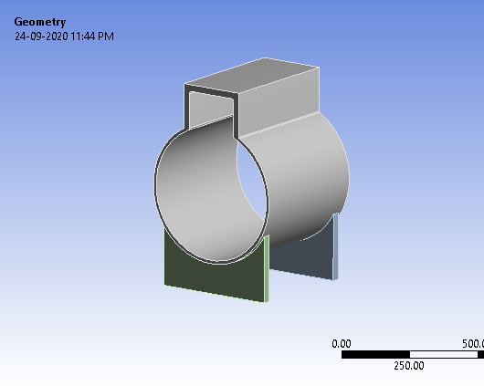
In this paper the limit load method is chosen to study a non-circular vessel components (shell) and out put is compared to the ASME section VIII div 2 Criterion.

Slide 12
Material Inputs
Components | Material | Yield strength | Young Modulus | Poisson ratio
Shell -Rectangular Portion | SA350 LF2 Cl1 | 250MPA | 1.98 E5 MPA | 0.3
Shell -Circular Portion | SA 516 Gr 70 N | 250MPA | 1.98 E5MPA | 0.3
Saddle supports | SA 516 Gr 70N | 250MPA | 1.98 E5MPA | 0.3
Note : The values are taken from ASME Section II D

Slide 13
Limit-load analysis method-(ASME requirement)
It can be done for single or multiple static loading condition.
Displacement and strain indicated by limit load analysis have no physical meaning. In this case thermal load can not be used .Other non load self limit load such as internal pressure & dead load can be used.
Establish lower bound to the limit load of structure using a numerical model with following properties
-Material model is Elastic Perfectly plastic model with specified yield strength
- Small displacement theory is employed
- Equilibrium is satisfied in the undeformed configuration

Slide 14
Limit-load analysis method
The point of plastic collapse is indicated by the inability or failure of the component to achieve an equilibrium solution for a load step.
In numerically in FEA software ,when increasing load steps, at a specific point the software will not able to converge solution when entire body or vessel component cross into to yielding and observe indefinite plastic flow in the elastic-Perfect model .This is considered numerically obtained limit load for the vessel components.

Slide 15
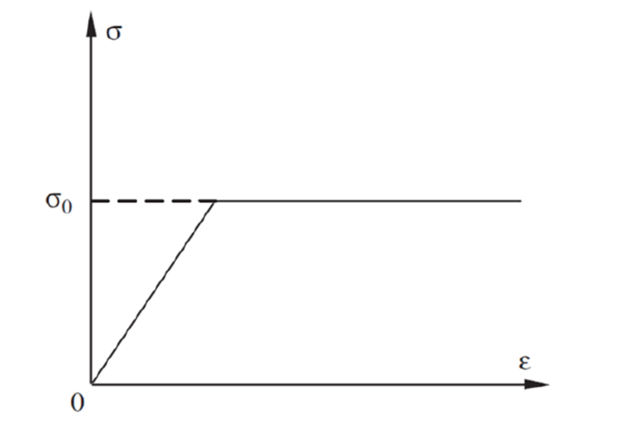
Limit-load analysis method
Elastic- Perfect plastic model

Slide 16
Limit-load analysis method
FEA software : Ansys work bench
Material model :Bilinear kinematic harden / Elastic-perfectly plastic model (tangent model is considered zero)
Boundary condition : X,Y,Z= 0 at Saddle support
Function type : Non Linear
Large deflection : Off mode
Internal Pressure : 0.32 MPA
Factored loads :0.48 Mpa

Slide 17
Limit-load analysis method
Factored loads : In this load case, internal pressure that factored according to ASME VIII-2 Table 5.4, 1.5 x P = 1.5 x 0.32 = 0.48 MPa. Thus 0.48 MPa was taken for internal loading. No other load such as internal or external pressure(P), static pressure(Ps) and dead load (D) are considered.

Slide 18
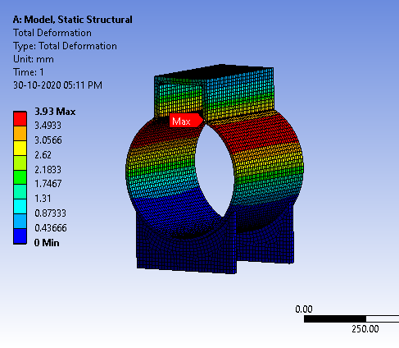
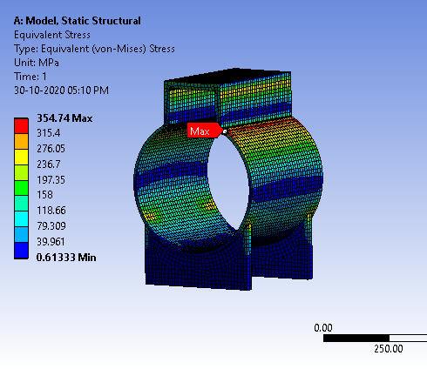
Limit-load analysis method (FE solution)
The internal loads are applied and the corresponding maximum Von-mises stress and maximum deformation observed in circular to rectangular junction(transition area). The deformation or displacement at transition portion helps to find out limit load (where collapse occurs).

Slide 19
Results and Conclusions
As per ASME Sec VIII div 2, the acceptance criterion is the solution convergence and this was achieved in the nonlinear solution. Thus, the vessel passes the limit load analysis.
But need to find out maximum limit load for plastic collapse. Further pressure were increased in incremental steps from 0.6 to 2.1 MPa and the Table 1 help to find out where collapse load had occurred as per obtained deformation at Shell & plastic strains

Slide 20
Results and Conclusions Table-1
 |  | Pressure ( MPA) | Shell Displacement at transition area (mm) | Von mises stress (Mpa) | Plastic Strain | Remark
 |  | 0.1 | 0.29 | 43.55 | 0 | converged
 |  | 0.2 | 0.59 | 86.92 | 0 | converged
 |  | 0.25 | 0.73 | 108.53 | 0 | converged
Internal Pressure |  | 0.32 | 0.93 | 138.71 | 0 | converged
 |  | 0.4 | 1.16 | 173.09 | 0 | converged
 |  | 0.44 | 1.28 | 190.24 | 0 | converged
Factor Load |  | 0.48 | 1.39 | 207.36 | 0 | converged
 |  | 0.6 | 1.73 | 258.54 | 0 | converged
 |  | 0.7 | 2.01 | 301.00 | 3.35E-05 | converged
 |  | 0.8 | 2.29 | 307.27 | 1.70E-04 | converged
 |  | 0.9 | 2.57 | 307.00 | 3.18E-04 | converged
 |  | 1 | 2.84 | 308.31 | 5.91E-04 | converged
 |  | 1.1 | 3.12 | 319.66 | 9.07E-04 | converged
 |  | 1.2 | 3.42 | 334.67 | 1.25E-03 | converged
 |  | 1.3 | 3.80 | 323.78 | 1.62E-03 | converged
 |  | 1.4 | 4.29 | 324.36 | 2.05E-03 | converged
 |  | 1.5 | 5.06 | 349.21 | 2.65E-03 | converged
 |  | 1.6 | 6.42 | 345.72 | 5.05E-03 | converged
 |  | 1.7 | 8.83 | 348.12 | 1.26E-02 | converged
 |  | 1.8 | 12.55 | 324.41 | 2.44E-02 | converged
 |  | 1.9 | 16.99 | 350.50 | 3.83E-02 | converged
Limit load |  | 2 | 21.60 | 325.66 | 5.31E-02 | converged
 |  | 2.1 | 86.19 | 346.61 | 2.95E-02 | Solution is not converged

Slide 21
Results and Conclusions Figure-1a

Slide 22
Results and Conclusions Figure-1b
Plastic strain Vs internal pressure
Internal Pr. 0.32 Mpa
Limit load(2.0 Mpa)

Slide 23
Results and Conclusions
The results from table 1 and Figure 1a&b shows the uncontrolled plastic flow (deformation) occurred at transition area at 2.1 Mpa internal loading.
The limit load 2.1 Mpa is higher than Factored load 0.48 MPA.
This gives the designer to establish safety factor for the combine load cases to have better conservative results .
Allow to establish Maximum allowable working pressure (MAWP, i.e. different from design Pressure)
To establish allowable load during pressure testing (hydro or pneumatic ) condition( 90-95 % of yield strength)
In FE model, the membrane stress, bending stress and peak stress components distribution will also be easily identify in rectangular and transition section, this gives the confidence to designer to design any for non regular geometry for specific design condition.

Slide 24
Results and Conclusions
It help to assign weld joint efficiency(E) for transition joint as this not standard weld joint configuration.
The configuration of rectangular portion of vessel the can easily adopt the vessel internal component such any demister or mist delimiter or steam collector.
The rectangular portion can used as tube sheet ,in this case welding joint configuration can be easily handled the welder to make sound weld than radial shape in cylinder.
Any super imposed load the vessel easily handle by rectangular portion than circular portion.

Slide 25
Reference
ASME Section 8 Division 2 and PTB -3
Booth M.R. Applying Finite Element Based Limit Load Analysis Methods to Structures Under Dynamic Loads. In Pressure Vessels and Piping Conference 2014 Jul 20 (Vol. 45981, p. V001T01A005). American Society of Mechanical Engineers.
Biel RC, Alexander C. Applications of Limit Load Analyses to Assess the Structural Integrity of Pressure Vessels. In ASME Pressure Vessels and Piping Conference 2005 Jan 1 (Vol. 4188, pp. 429-439).

